Slide 1




PIZZA HUT
pizza sales analysis
Presented by Sweety Srivastava
Data analyst

Slide 2
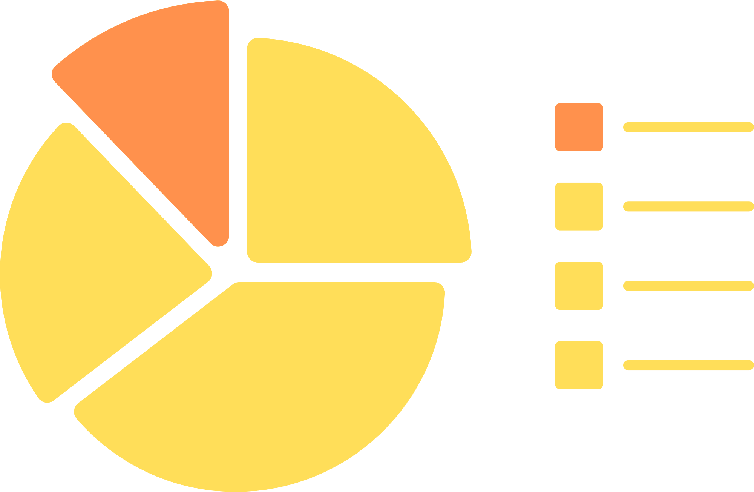
PIZZA HUT
INTRODUCTION
The Pizza Sales Analysis project aims to provide comprehensive insights into the sales performance of pizza hut. By leveraging SQL, this project will analyze various aspects of the sales data, including revenue trends and product performance. The goal is to identify patterns and opportunities for optimizing the business strategy, enhancing customer satisfaction, and increasing profitability.

Slide 3

PIZZA HUT
DATA COLLECTION
Data Sources
GitHub Repository: We sourced our dataset from a well-documented and frequently updated GitHub repository dedicated to pizza sales. The dataset included various aspects of sales transactions, customer information, and product details.

Slide 4

PIZZA HUT
Types of Data Collected
Sales Transactions: Detailed records of each sale, including the date, time, and total amount of the transaction.
Product Details: Information about the different types of pizzas sold, including sizes, category ,quantity and prices.

Slide 5

PIZZA HUT
Agenda (Basic)
01
Retrieve the Total Number of Orders Placed
SQL query to count the total number of orders.
04
Identify the Most Common Pizza Size Ordered
SQL query to determine the most frequently ordered pizza size.
02
Calculate the Total Revenue Generated from Pizza Sales
SQL query to sum the total sales revenue.
05
List the Top 5 Most Ordered Pizza Types Along with Their Quantities
SQL query to find the top 5 pizza types and their order quantities.
03
Identify the Highest-Priced Pizza
SQL query to find the pizza with the highest price.

Slide 6
PIZZA HUT
Agenda (Intermediate)
06
Join Necessary Tables to Find the Total Quantity of Each Pizza Category Ordered
SQL query to join tables and aggregate the total quantity for each pizza category.
09
Group the Orders by Date and Calculate the Average Number of Pizzas Ordered per Day
SQL query to group orders by date and calculate the average daily order count.
07
Determine the Distribution of Orders by Hour of the Day
SQL query to analyze the distribution of orders across different hours of the day.
10
Determine the Top 3 Most Ordered Pizza Types Based on Revenue
SQL query to find the top 3 pizza types by revenue.
08
Join Relevant Tables to Find the Category-Wise Distribution of Pizzas
SQL query to join tables and determine the distribution of orders by pizza category.

Slide 7
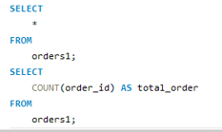

PIZZA HUT
1 . Retrieve the total number of orders placed
The data indicates a robust customer base, with a substantial total number of orders placed. This highlights consistent demand and customer engagement with our product offerings.

Slide 8
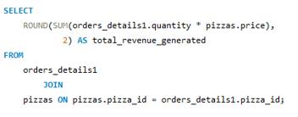

PIZZA HUT
2. Calculate the total revenue generated from pizza sales.
The total revenue generated from pizza sales underscores the financial health and profitability of our business. This revenue reflects our pricing strategy and the overall popularity of our pizzas.

Slide 9
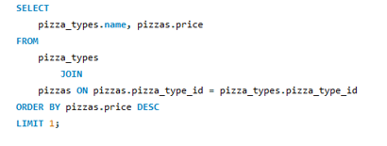

PIZZA HUT
3 . Identify the highest-priced pizza.
Identifying the highest-priced pizza allows us to understand the premium segment of our product line. This information can be used to strategize on product placement and marketing for high-value offerings.

Slide 10
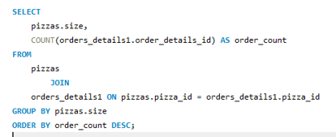
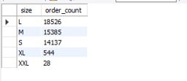
PIZZA HUT
4 . Identify the most common pizza size ordered.
The most commonly ordered pizza size provides insight into customer preferences and helps optimize inventory management. This preference can guide promotional strategies and pricing adjustments.

Slide 11
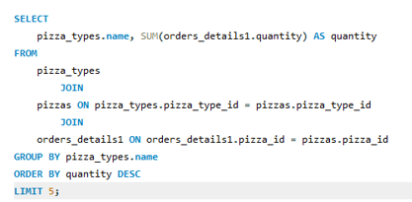

PIZZA HUT
5 . List the top 5 most ordered pizza types along with their quantities.
Understanding the top 5 most ordered pizza types and their quantities helps us recognize our best-selling products. This information is crucial for inventory planning, menu optimization, and targeted marketing efforts.

Slide 12
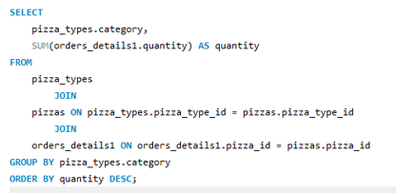

PIZZA HUT
6 . Join the necessary tables to find the total quantity of each pizza category ordered.
The distribution of orders across different pizza categories reveals customer preferences for specific types of pizzas, such as classic, specialty, or premium categories. This data can guide future product development and category expansion.

Slide 13
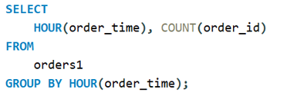
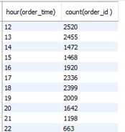
PIZZA HUT
7 . Determine the distribution of orders by hour of the day.
Analyzing the hourly distribution of orders provides insights into peak hours and customer ordering behavior. This can inform staffing decisions, promotional timing, and operational efficiencies.

Slide 14


PIZZA HUT
8 . Join relevant tables to find the category-wise distribution of pizzas.
The category-wise distribution helps us understand which types of pizzas are most popular. This information can influence marketing campaigns and menu adjustments to cater to customer tastes

Slide 15
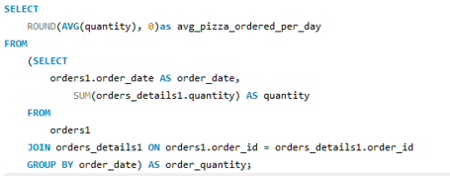

PIZZA HUT
9 . Group the orders by date and calculate the average number of pizzas ordered per day.
Grouping orders by date and calculating the average number of pizzas ordered per day allows us to identify trends, seasonal variations, and daily sales patterns. This data is essential for demand forecasting and planning.

Slide 16
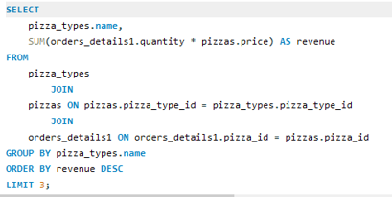

PIZZA HUT
10 . Determine the top 3 most ordered pizza types based on revenue.
Identifying the top 3 pizza types contributing the most to revenue provides insight into our most profitable products. This knowledge can guide pricing strategies, promotional efforts, and product positioning.

Slide 17
PIZZA HUT
Conclusion: Pizza Sales Analysis
The analysis demonstrates the importance of data-driven decision-making in enhancing customer satisfaction, optimizing inventory, and maximizing revenue. By leveraging these insights, we can refine our product offerings, improve customer experiences, and strategically grow our business.
Future efforts should focus on understanding customer preferences even further, exploring opportunities for new product introductions, and optimizing our operations to meet demand efficiently. Additionally, targeted marketing and promotions can help capitalize on popular products and peak ordering times, ultimately driving growth and profitability.
In summary, our pizza sales analysis provides a strong foundation for informed business strategies, ensuring that we continue to meet and exceed customer expectations while achieving our financial goals.

Slide 18
THANK YOU

